Slide 1
Model Risk Management
Chapter 22

Slide 2
Uses of Models
Credit decisions and credit exposures
Liquidity management
Derivatives valuation
Calculation of VaR, ES, and other risk measures
Asset management
Fraud detection
etc

Slide 3
SR 11-7
SR11-7 from the U.S. Board of Governors provides guidance to banks on model risk management
Model risk is defines as “the potential for adverse consequences from decisions based on incorrect or misused model outputs and reports”
Model risk can arise from
  fundamental errors involving data, calculations, numerical procedures, and assumptions
  Inappropriate use of the model

Slide 4
SR 11-7 continued
SR11-7 contains directives on
  Model development, testing, and documentation
  The role of model validation groups
  The use of vendor models

Slide 5
Finance vs Physics (Section 22.2)
The models of physics describe physical processes and are highly accurate. Their parameters do not change through time.
The models of finance describe human behavior. They are at best approximations. Parameters do change through time

Slide 6
Linear Products
Very little uncertainty about the right model
But mistakes do happen. For example…
  Kidder Peabody (Business Snapshot 22.2)
  In Arrears Swaps (Business Snapshot 22.3)
It is important to monitor trading patterns. Getting a lot of business of a certain type can indicate that your models are wrong.

Slide 7
Models for Pricing Actively Traded products
We do not need usually a model to know the price of an actively traded product. The market tells us the price.
The model is a communication tool (e.g., implied volatilities are quoted for options)
It is also an interpolation tool (e.g., a tool for interpolating between strike prices and maturities.

Slide 8
The Procedure
Observe model prices for similar instruments that trade
Imply model parameters. Interpolate as appropriate
Value new instrument

Slide 9
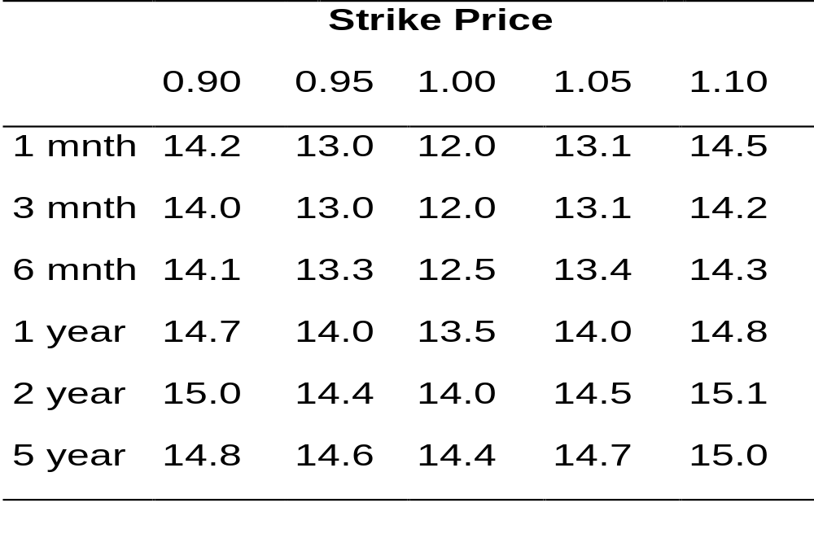
Example of a Volatility Surface for Actively Traded Options on an Exchange Rate
(Table 22.1)
How would you price a 1.5 year option with a strike price of 0.92?

Slide 10
Model risk for Actively Traded Products
Little pricing risk in most cases
Hedging performance can depend on the model used and should be carefully investigated

Slide 11
P&L Decomposition (Section 22.4.3)
Distinguishes between:
P&L changes from risks that were unhedged
P&L changes from the hedging model being imperfect
P&L changes from new trades done during day

Slide 12
Models for Less Actively Traded Products (Section 22.5)
In the case of less actively traded products, models play a key role in both pricing and hedging

Slide 13
Pricing Risk for Less Actively Traded Instruments
  Use more than one model for pricing.
  Calibrate all models used to the prices of actively traded instruments
  Create reserve accounts so that profits are not recognized immediately
  Use weighted Monte Carlo to determine the range of models that price actively traded standard instruments consistently with the market.

Slide 14
Marking the Prices of an Instrument to Market
Use prices quoted by market maker
Use price at which financial institution has traded product
Use prices from SEFs or interdealer brokers
Use price indications
Use model (marking to model)

Slide 15
Accounting
FASB 157 and IASB 39 classify instruments as “held for sale” or “held to maturity”
Those classified as held for sale have to be marked to market
  Level 1: uses quoted prices in active markets
  Level 2: uses quoted prices for similar product in active markets or same product in non-active markets
  Level 3: requires valuation assumptions

Slide 16
Model Building Missteps (Section 22.8)
Overfitting
Overparametrization
Making the model so complicated that the intended user will not be able to use it
Black-Scholes has been successful because it is a simple interpolation tool that structures the trader’s thinking about the market

